Slide 1

MCTV Limited
Software Applications for Business

Slide 2
Higher Certificate Science in Computing Applications and Business Support
2nd Semester 2017-2018
Due on April 21st

Slide 3
Work done by
Heba Mahmoud - x17139660
Luciano Dwyer-Joyce - x17123089
Ricardo Santos - x16149912

Slide 4
Table of contents
Presentation
Introduction
Tasks
Gantt Chart
Database
UML
Software and User guides
Color Scheme
Links
Conclusion

Slide 5
Presentation
Over the next slides we will present everything we did over the last weeks about our project.
We will also present our company and all we did and all the software we used to do all the tasks we were asked to do.

Slide 6
Introduction
MCTV Limited it is a family company based in Limerick.
The family members are currently looking to make the company grow.
The family leader announced that they have €100.000,00 available to make that growth possible.
Each one of the members has his / her thoughts about how the money should be invested.

Slide 7
Tasks
Microsoft Database | Heba and Luciano
UML (Use Case Diagrams) | Ricardo
GitHub for File Management | We all used and uploaded files there
Trello for mapping tasks | We all did it
Gantt Chart | Ricardo
WordPress website | Heba
Report with User guide | 1 each member
Presentation | Ricardo

Slide 8
Gantt Chart

Slide 9
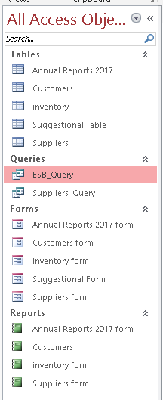
Database overview
As part of this CA we had to do a Access Database, that we will show you now.
Press Here

Slide 10
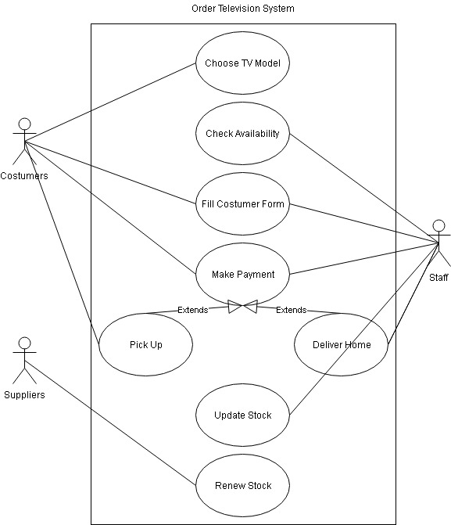
UML Chart overview

Slide 11
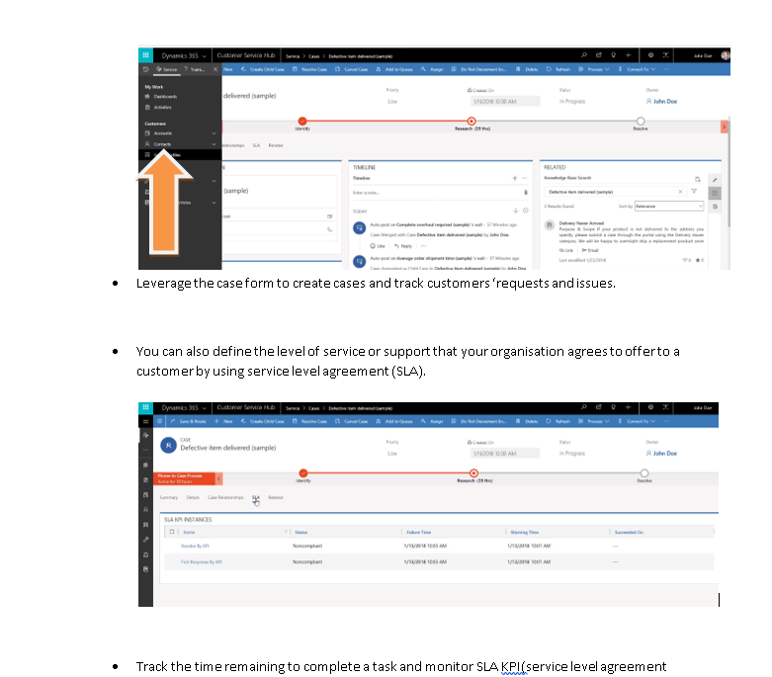
Heba software and User guide
Heba decided to play the role of Derek.
Playing the role of Derek, Heba investigated the Microsoft Dynamics software.

Slide 12
Luciano software and User guide
Luciano decided to play the role of Liam.
Playing the role of Liam, Luciano investigated a Collaborative Software.

Slide 13
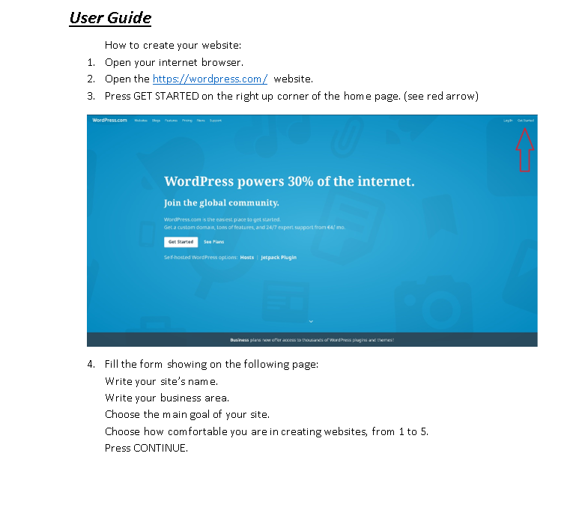
Ricardo software and User guide
Ricardo decided to play the role of Mark.
Playing the role of Mark, Ricardo investigated the WordPress platform.

Slide 14
Links
Here, you can find the links to our GitHub project and to our WordPress website:
WordPress
GitHub

Slide 15
Colour Scheme
For our colour scheme, we chose the BLUE colour.
After a conversation between the group members, and a fast research on the biggest internet websites, we saw that all of them use the blue colour.
We all agreed about using the blue colour, because it is smooth and pleasing to the eyes.

Slide 16
Conclusion

Slide 17







